Slide 1
Lagrangian Interpolation

Slide 2
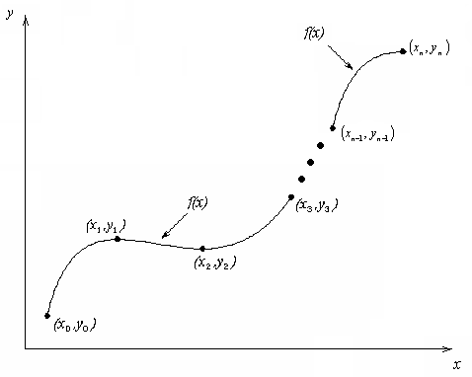
What is Interpolation ?
Given (x₀,y₀), (x₁,y₁), …… (x_{n},y_{n}), find the value of ‘y’ at a value of ‘x’ that is not given.
http://numericalmethods.eng.usf.edu

Slide 3

Interpolants
Polynomials are the most common choice of interpolants because they are easy to:
  Evaluate
  Differentiate, and
  Integrate.
http://numericalmethods.eng.usf.edu

Slide 4
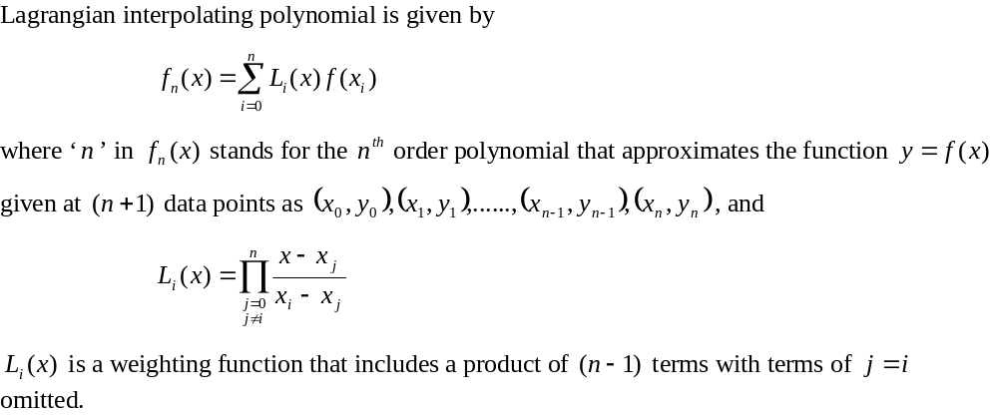
Lagrangian Interpolation
http://numericalmethods.eng.usf.edu

Slide 5
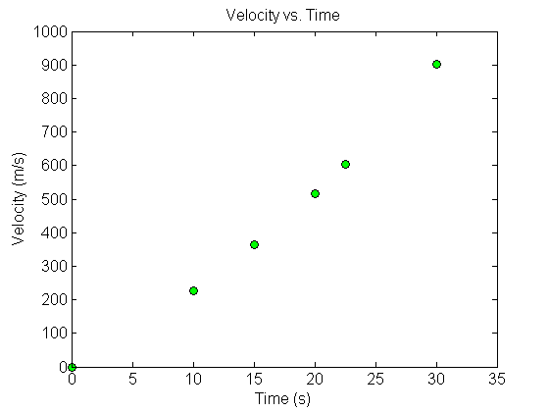



Example
The upward velocity of a rocket is given as a function of time in Table 1. Find the velocity at t=16 seconds using the Lagrangian method for linear interpolation.
Table Velocity as a
function of time
(s) | (m/s)
0 | 0
10 | 227.04
15 | 362.78
20 | 517.35
22.5 | 602.97
30 | 901.67
Figure. Velocity vs. time data
for the rocket example
http://numericalmethods.eng.usf.edu

Slide 6
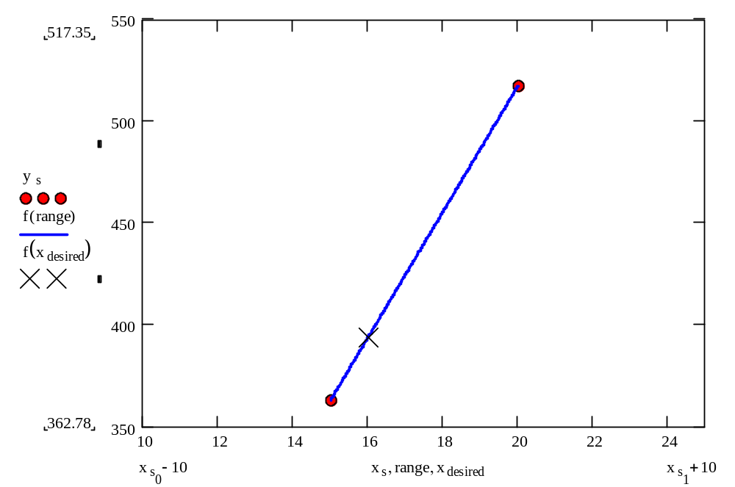
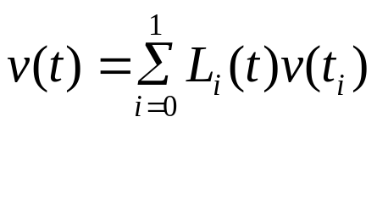

Linear Interpolation
http://numericalmethods.eng.usf.edu

Slide 7
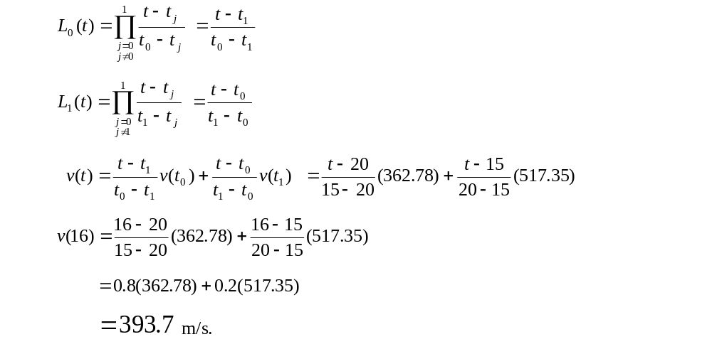
Linear Interpolation (contd)
http://numericalmethods.eng.usf.edu

Slide 8
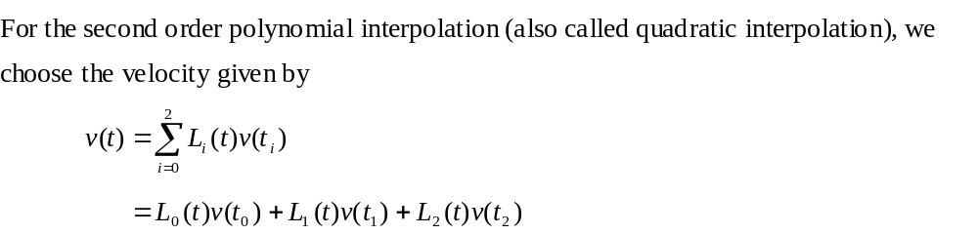
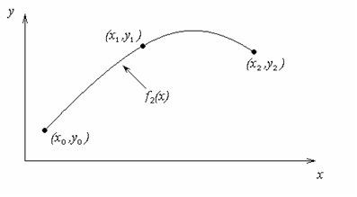
Quadratic Interpolation
http://numericalmethods.eng.usf.edu

Slide 9
Example
The upward velocity of a rocket is given as a function of time in Table 1. Find the velocity at t=16 seconds using the Lagrangian method for quadratic interpolation.
Table Velocity as a
function of time
(s) | (m/s)
0 | 0
10 | 227.04
15 | 362.78
20 | 517.35
22.5 | 602.97
30 | 901.67
Figure. Velocity vs. time data
for the rocket example
http://numericalmethods.eng.usf.edu

Slide 10
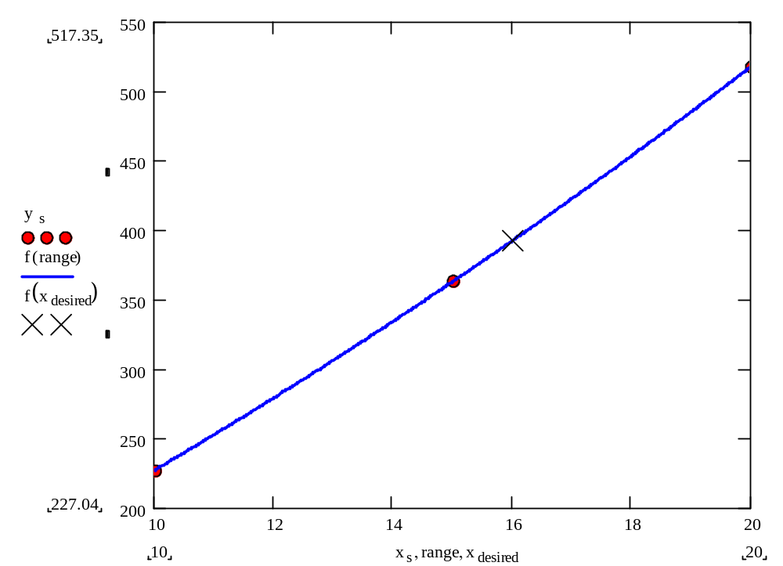
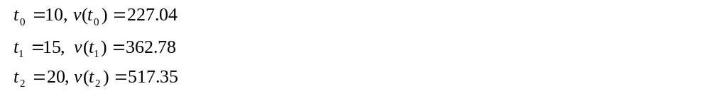
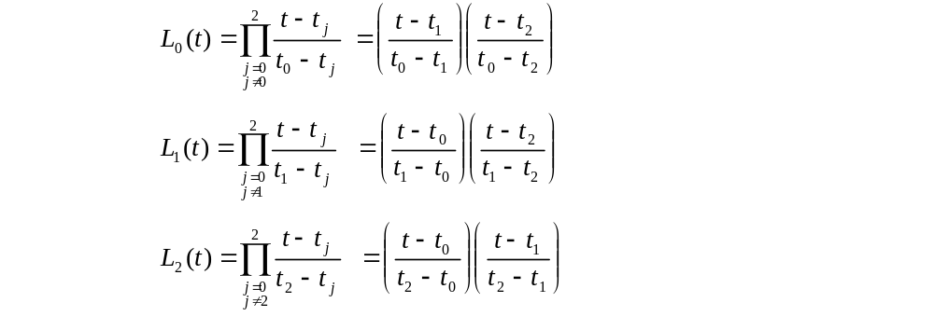
Quadratic Interpolation (contd)
http://numericalmethods.eng.usf.edu

Slide 11
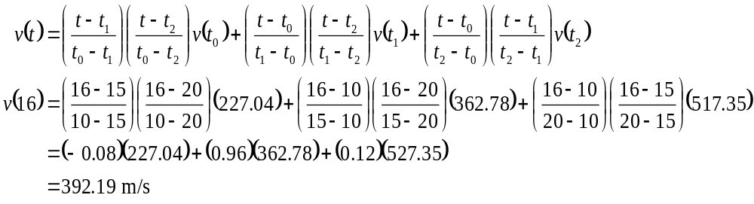

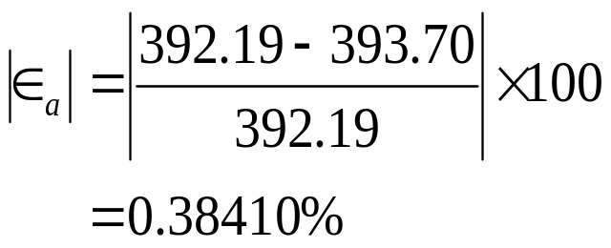
Quadratic Interpolation (contd)
The absolute relative approximate error obtained between the results from the first and second order polynomial is
http://numericalmethods.eng.usf.edu

Slide 12
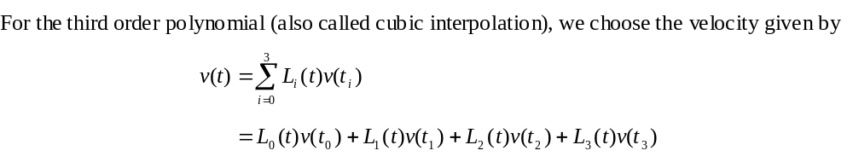
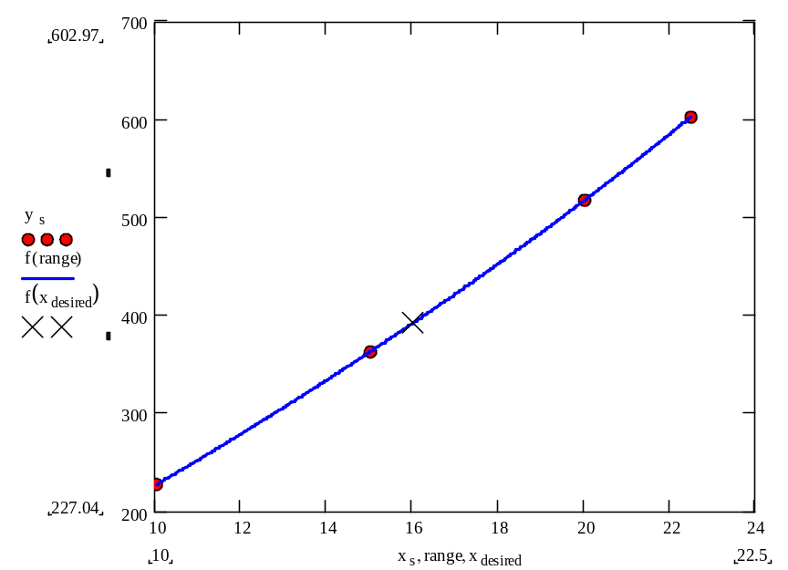
Cubic Interpolation
http://numericalmethods.eng.usf.edu

Slide 13
Example
The upward velocity of a rocket is given as a function of time in Table 1. Find the velocity at t=16 seconds using the Lagrangian method for cubic interpolation.
Table Velocity as a
function of time
(s) | (m/s)
0 | 0
10 | 227.04
15 | 362.78
20 | 517.35
22.5 | 602.97
30 | 901.67
Figure. Velocity vs. time data
for the rocket example
http://numericalmethods.eng.usf.edu

Slide 14
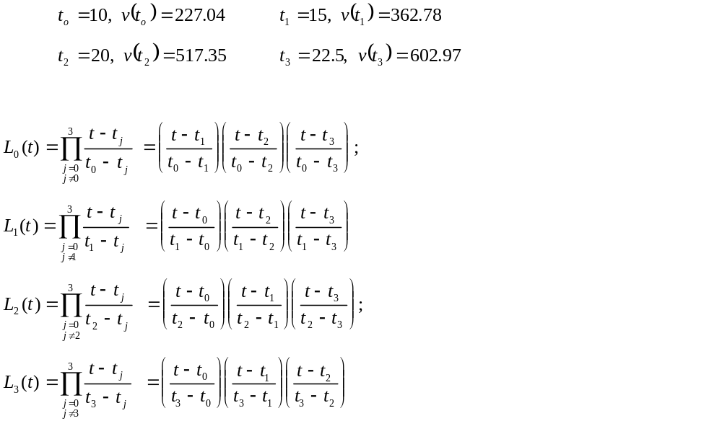
Cubic Interpolation (contd)
http://numericalmethods.eng.usf.edu

Slide 15
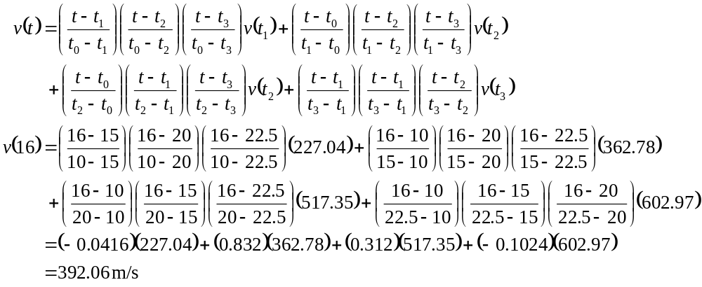
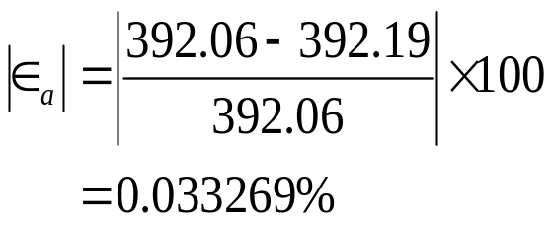
Cubic Interpolation (contd)
The absolute relative approximate error obtained between the results from the first and second order polynomial is
http://numericalmethods.eng.usf.edu

Slide 16
Comparison Table
Order of Polynomial | 1 | 2 | 3
v(t=16) m/s | 393.69 | 392.19 | 392.06
Absolute Relative Approximate Error | -------- | 0.38410% | 0.033269%
http://numericalmethods.eng.usf.edu

